Slide 1
Assignment 5 problems solved with synchronization Mechanisms
Abdel Aitroua, Matthew Schenk, Samuel Weems

Slide 2
Problem vs Synchronization Mechanisms
Smoker Problem solved with Semaphores
Roller Coaster Problem solved with Monitors
Temperature Synchronization solved with Mailboxes

Slide 3
Smokers Problem
A smoker requires Paper, Tobacco, and Matches to smoke
3 types of smokers, based on what they require to smoke:
Matches & Tobacco
Matches & Paper
Tobacco & Paper
1 table that will hold those three ingredients
Without synchronization this problem can experience:
deadlock

Slide 4
Solved with Semaphore
Counting or General Semaphore utilizing an integer value for signaling among processes, to keep track of what is available. This way no process can act unless it has the appropriate resources.
3 smoker semaphores, for each smoker type
1 agent semaphore, so the agent can put the items on the table
3 pusher semaphores, to release the next smoker type that needs those items

Slide 5
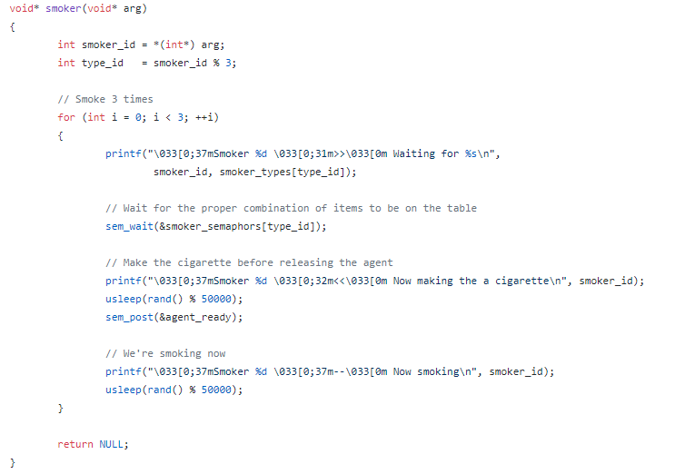
Critical Section: Smoker

Slide 6
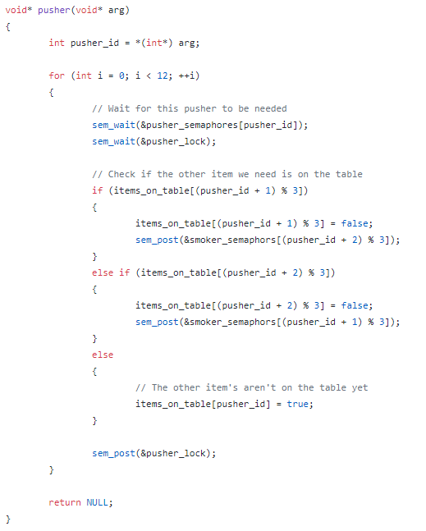
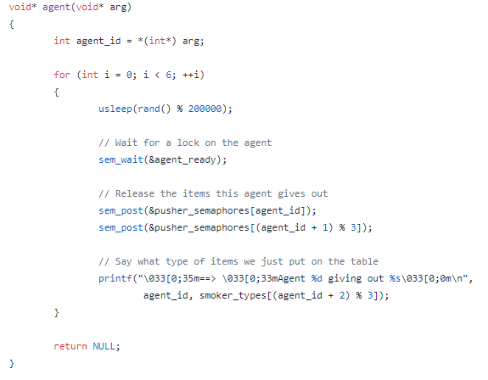
Critical Section: Pusher and Agent

Slide 7
Explanation
With each of these critical sections calling wait, if the counter decrements to a negative number then that process/thread/smoker/pusher/agent is blocked and must wait.
Since the agent semaphore has the only value of 1, it is the critical section that will execute first, placing items on the table, followed by the pusher allowing the correct smoker type access to the table, followed by the smoker smoking.

Slide 8
Key Points, Conclusion, & Compile
Counting Semaphores ensure Mutual Exclusion, by using integers to keep track of the number of blocked processes( Negative numbers) or resources available (positive numbers).
Initializing them to 0, ensures that all processes will wait until they are signaled to proceed.
Compile: gcc -std=gnu99 -Wall -pedantic -pthread main.c -o smoke Execute: ./smoke
Don’t smoke.

Slide 9
Roller Coaster Problem
The Roller Coaster problem requires two things: RollerCoaster Car and Passengers
May also include multiple cars
The Car will go around the track when it is full of passengers
Passengers will ride the rollercoaster, and then may come back for another ride
Without Synchronization this problem can experience
Deadlock
Race Condition

Slide 10
Solved with Monitor
A programming language construct that encapsulates variables, access procedures and initialization code within an abstract data type.
In this case, utilizing libraries in java:
java.util.concurrent.locks.Condition
java.util.concurrent.locks.ReentrantLock
This allows for variables that can be allocated the data types Condition and ReentrantLock, allowing for monitor synchronization impemntation

Slide 11
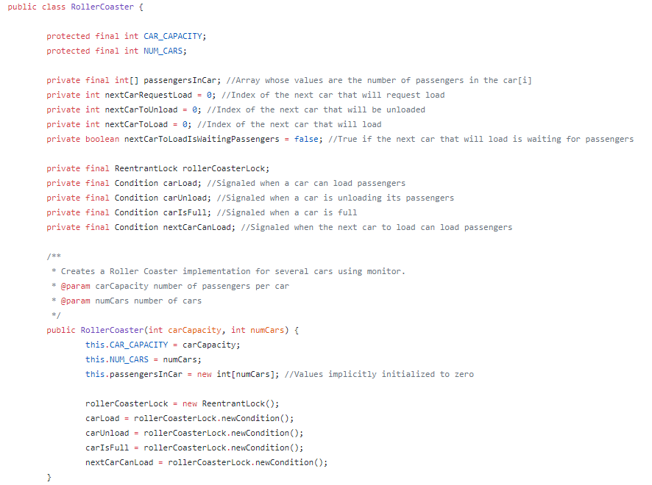
Variable Initialization

Slide 12
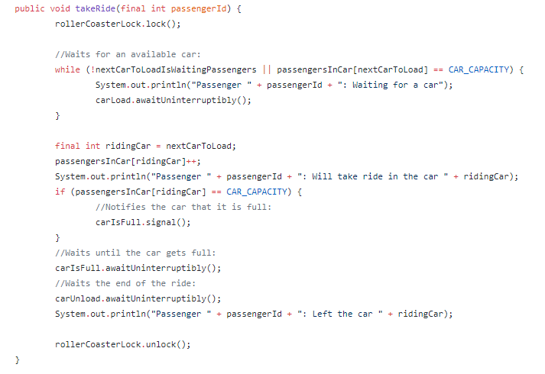
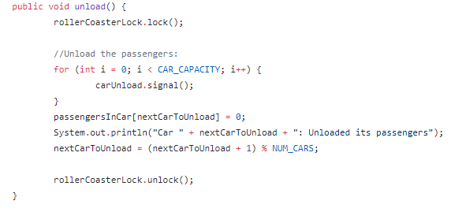
Critical Sections: Method Calls Accessing Monitor

Slide 13
Explanation
The critical section for this class is when the condition variables are locking and unlocking the monitor, each having their own queue
If they can not unlock the monitor, they must wait in a queue until the monitor is unlocked
Condition provides a means for one thread to suspend execution until notified, with they key that waiting for a condition provides that it atomically releases the associated lock and suspends the current thread, like .wait()

Slide 14
Key Points, Conclusion, & Compile
Monitors are often abstract data types that when utilized, have instances locking the class so one instance at a time may access it
The rollercoaster is the monitor that is locked when a passenger attempts to get on, and when the passenger is waiting until the car is full, it releases the lock on the rollercoaster but is suspended until that condition is met
Utilizing lock and condition from java.util can work well together allowing multiple processes access to a critical section within a monitor
Compile: javac *.java and Execute: java Main

Slide 15
Temperature Stabilization Problem
Four processes(clients) are communicating with a central process(server), relaying temperature data
The temperature should be stabilized, becoming the same temperature in each of the processes through communication with only the central process
One stable, the central process will notify the others of the current state of the system
This gives us a one to many scenario.

Slide 16
Solved with Mailbox/Messages
Means for two processes to exchange information, and that may be used for synchronization
In this case utilizing sys/msg.h, msgget(), msgsnd(), msgrcv()
After setting up the mailboxes, information is passed via a struct from each process to the central process, which returns the status of the system
Processes keeping executing until the temperature is stabilized
Problems that can arise with Synchronization
Deadlock
Race Condition

Slide 17
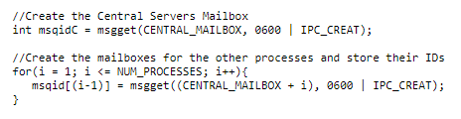

Mailbox Initialization

Slide 18
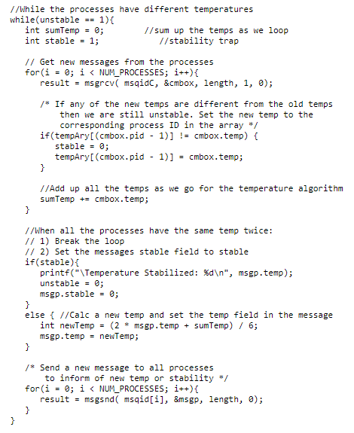
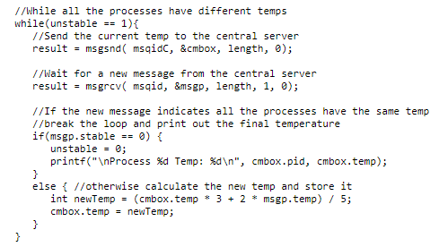
Critical Section Synchronization Server vs Client

Slide 19
Explanation
Each process has its own mailbox, where it receives data in the form of a struct that describes the message
Utilizing the data received it follows the logic dictated by the instructions for the process
Through this passing of data, synchronization is ensured and the temperature is stabilized for the processes through communication with the central process

Slide 20
Key Points, Conclusion, and Compile
The struct contains key elements of a message:
Message Type
Destination ID
Source ID
Message Length
Control Information
Message Contents
Utilizing a both sender and receiver as blocking types ensure that the mssage is delivered and allows for tight synchronization
Compile Commands: gcc -o external.out external.c gcc -o central.out central.c
Run each process in a separate terminal like so: ./external.out 100 1, ./external.out 22 2
./external.out 50 3, ./external.out 40 4, ./central.out 60

Slide 21
References
Colmenares, Eduardo. “CMPS 5143: Advance Computer Architecture.” Midwestern State University. Bolin 309, Wichita Falls, TX. April 2016. Lecture
https://github.com/EvanPurkhiser/CS-SmokersProblem/blob/master/smoke.c
https://github.com/rafaelsales/ConcurrentProgramming/tree/master/ConcurrentJavaRollerCoaster/src/rafael/concurrent/monitor/rollercoaster
https://macboypro.wordpress.com/2009/05/15/posix-message-passing-in-linux/
http://pubs.opengroup.org/onlinepubs/7908799/xsh/sem_init.html
http://pubs.opengroup.org/onlinepubs/7908799/xsh/sem_wait.html
http://pubs.opengroup.org/onlinepubs/7908799/xsh/sem_post.html
http://www.csc.villanova.edu/~mdamian/threads/javamonitors.html
https://docs.oracle.com/javase/7/docs/api/java/util/concurrent/locks/ReentrantLock.html
https://docs.oracle.com/javase/7/docs/api/java/util/concurrent/locks/Condition.html

